Slide 1

perfect erp solution for managing
colleges & universities

Slide 2
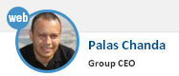
Your team is magical. Very impressed with the ability to take on activities and deliver...
Few words from our client that rightly sums up our commitment to our customers

Slide 3




eCAMPUS
Comprehensive ERP solution for any educational institution, large or small.
Covers all areas of institution management, right from Pre-admission stage till the completion of student course.
Over 30+ modules, covering all aspects of institute operation
We customise the application to suit individual institution requirement
DEPARTMENT-WISE
OPERATION
ROLE - BASED
ACCESS CONTROL
100% MODULES
COVERED
OPERATIONAL
TRACKING

Slide 4

Why eCAMPUS
INTEGRATED SOLUTION
PRE-ADMISSION TO CERTIFICATION – ALL ASPECTS COVERED
EXTREMELY SIMPLE BUT PROCESS ORIENTED
INTERACTIVE
INDIVIDUAL ACCESS ID FOR EVERY MEMBER
COMMUNICATION BETWEEN EACH OTHER
MODULAR APPROACH
OVER 37 DIFFERENT MODULES OF OPERATION
CAN BE ADOPTED IN PHASED MANNER

Slide 5
Technical Strength
EASY ACCESS
BROWSER BASED APPLICATION
ANYTIME ANYWHERE USE ON 24*7 BASIS
LATEST TECHNOLOGY
BUILT ON MOST ROBUST PLATFORM USING RESPONSIVE TECHNOLOGY
HOSTED ON DEDICATED SERVERS WITH TRIPLE LAYER BACKUP
EASE OF USE WITH EFFECTIVE PROTECTION
ROLE BASED ACCESS TO INDIVIDUAL THRU ADMIN ACCESS CONTROLS
READY AND EASY ACCESS TO MULTIPLE YEAR DATA
ACCESSIBLE THROUGH MULTIPLE DEVICES & PLATFORMS
SUPPORTS MULTIPLE CHANNEL OF COMMUNICATION (SMS & E-MAIL)
EXTERNAL DEVICE INTEGRATION ( BARCODE, ACCESS CARD, ONLINE PAYMENTS)

Slide 6
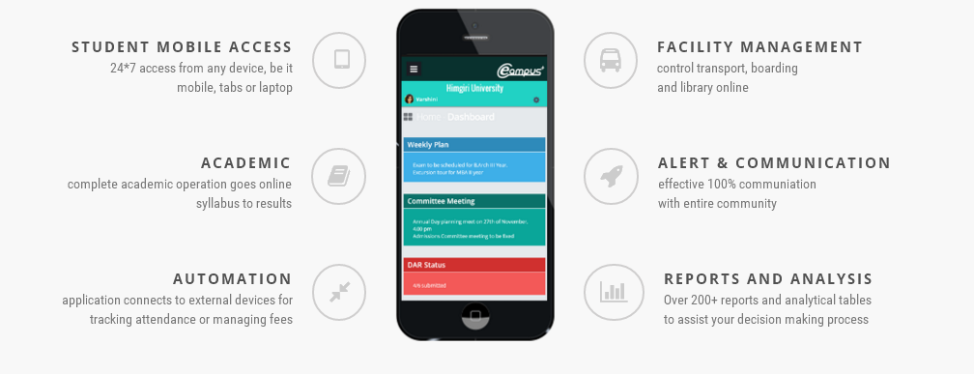
Salient Features

Slide 7

100% Finance Control
APPROVAL LIMITS
Set individual limits of approval, role based
APPROVAL PROCESS
Every rupee spent is remitted after passing through set process only
REPORTS & ANALYSIS
Complete tracking of pendencies & spents at all levels
BUDGET
Department or Overall
MANAGING THE FINANCIAL OPERATION EFFICIENTLY

Slide 8
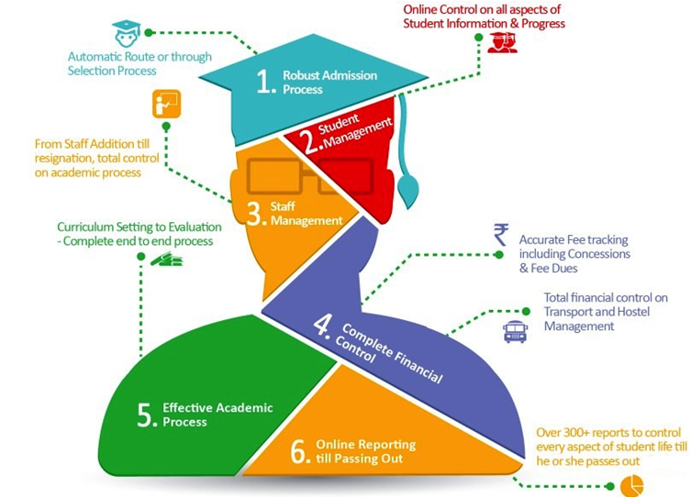
Application Modules span...

Slide 9





Operating “A”s
ADMISSIONS
All operations starting from lead management to completion of facility allocation
ACADEMIC
Calendar scheduling to homework / assignment / evaluation management
ADMINISTRATION
Attendance, Staff management Transport, Boarding,
Communications,
and other areas ...
ACCOUNTS
Full fledged financial control
including fees / asset
inventory, budgeting
and approval limits

Slide 10
ADMISSIONS
LEAD MANAGEMENT
ADMISSION PROCESS
Track every enquiry to the source to improve marketing spend efficacy. Follow-up on prospect candidates to final admission
Direct Admission or through interview/test,
eCAMPUS provides easy solution to all the
options on admission
WEBSITE CONTROL
FACILITY ALLOCATION
Maintain the website with latest updates
through automatic “update control” panels on eCAMPUS
Follow-up the admission to complete other
formalities like Hostel Allocation, ID card issue
Transport allocation directly on eCAMPUS

Slide 11
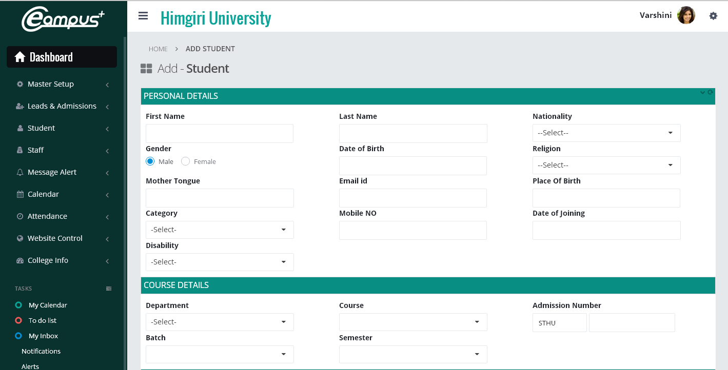
Screenshot – Student Addition

Slide 12
ADMINISTRATION
STAFF MANAGEMENT
EVENT CALENDAR
From recruitment to leave tracking and employee settlement, control all activities
under one roof.
Complex event calendar, with departmental inputs automatically added and shared with entire team
STUDENT MANAGEMENT
COMMUNICATION
Complete control of all student activities during the stay of the student in the campus / duration of the course.
Automated and manual communication to entire community, in selected state or complete through email or SMS .

Slide 13
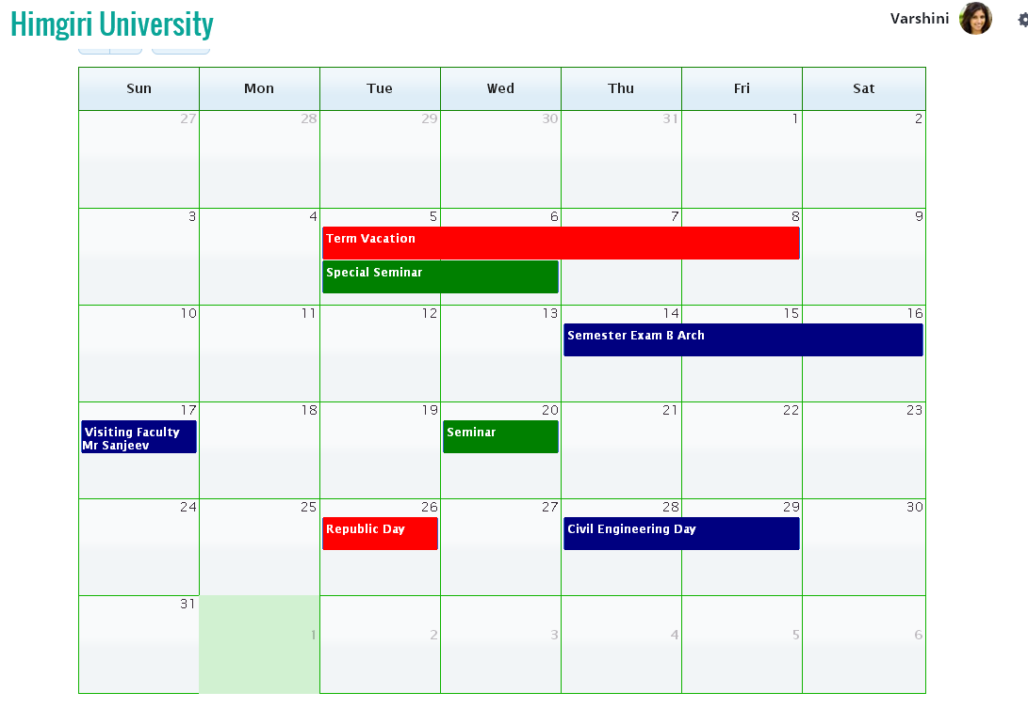
Screenshot – Interactive Calendar

Slide 14
ACADEMICS
TIMETABLE
HOMEWORK / ASSIGNMENT
Department and course-wise timetable,
with provision for multiple faculty per
subject.
Complete control on the student academic process, through effective provisioning of online assignments and tracking of the same
EVALUATION
CERTIFICATION & ROLLOVER
Independent modules for setting up of evaluation criteria, frequency, process and finally delivery of results to students, both online and offline
Final stage of the academic process, involving of actual issuance of progress report, followed by the rollover of student to next academic year or semester.

Slide 15
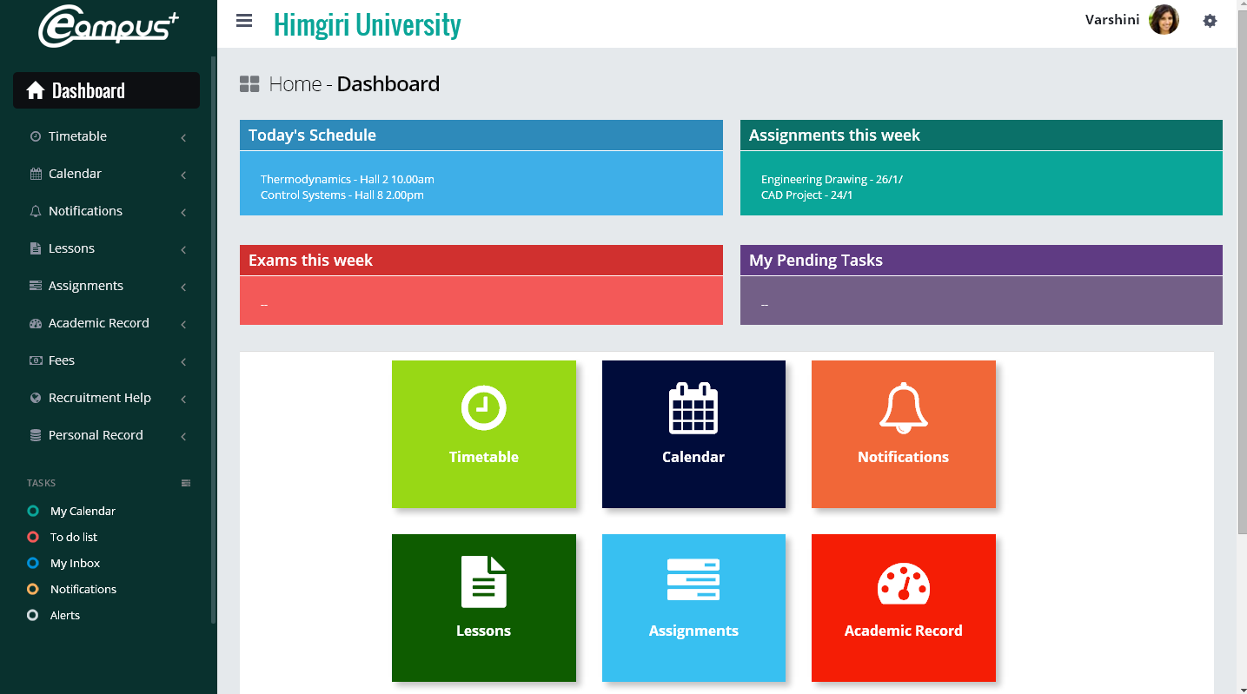
Screenshot – Student HomePage

Slide 16
ACCOUNTS
FEE MANAGEMENT
ASSET MANAGEMENT
Complete automation of fee management, including fee collection , both manually and through online process
Complete control of all assets spread across the campus. Separate module for consumables, which is managed through Inventory Management
PAYROLL MANAGEMENT
FINANCE CONTROLS
Full control of staff salary, which is interlinked with the staff leave module, incentive module and staff loans module
Complete control of campus finances, which starts from Budgeting, to Accounting. Comes with role based sanction limits and automatic alerts to next approver .

Slide 17
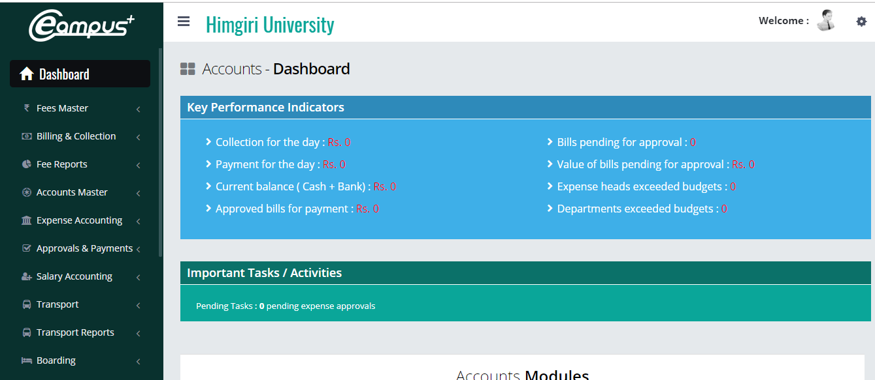
Screenshot – Accounts Home page

Slide 18
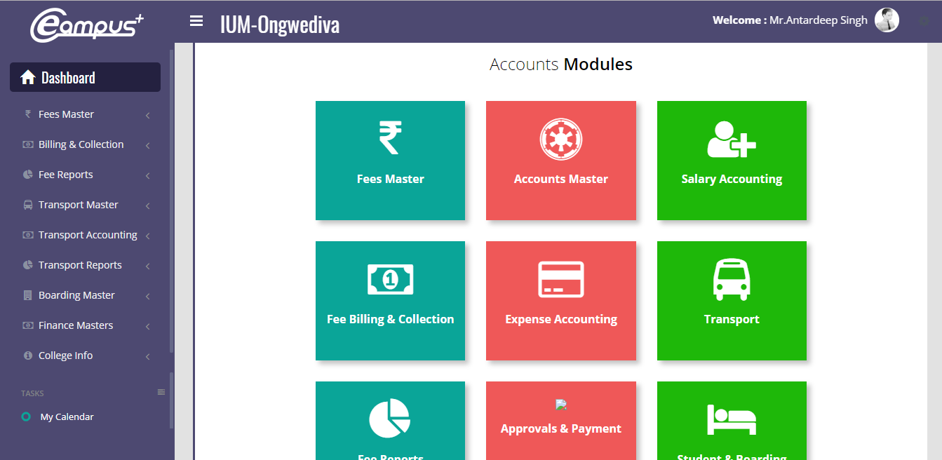
Screenshot – Accounts Home page

Slide 19
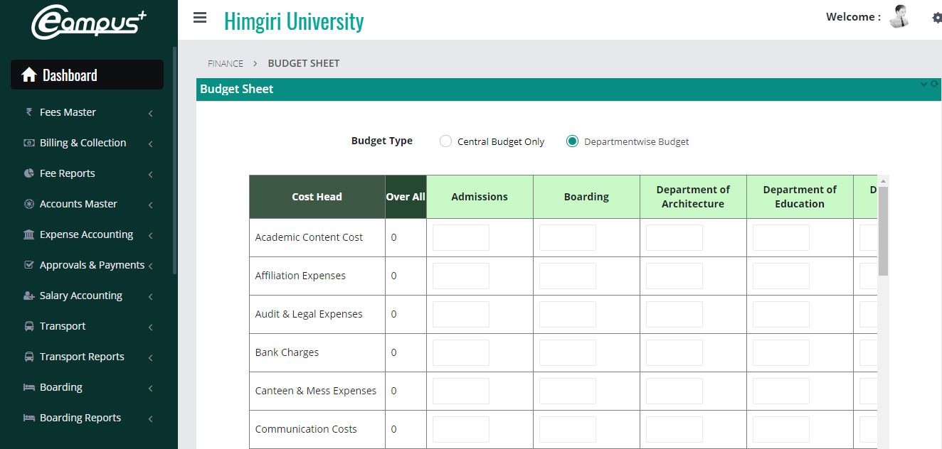
Screenshot – Accounts Home page

Slide 20
Effective Monitoring Reports...
BUILT-IN EFFICIENCY REPORTS
SIMPLE & QUICK ATTENDANCE PROCESS
STAFF WORKLOAD & STAFF SUBSTITUTION
TRACKERS FOR TIMETABLE , EXAM, ASSIGNMENT
TRACKER ON FACILITY UTILISATION
TRACKER FOR STAFF & STUDENT DOCUMENTS
MONITORING THROUGH COMMITTEES
ONLINE STUDENT AND PARENT FEEDBACK
ONLINE APPRAISAL OF STAFF MEMBERS
COMPLETE FINANCIAL CONTROL
DETAILED FEES MANAGEMENT
CONTROL ON FEE CONCESSIONS
SPECIALISED “CAMPUS” ACCOUNTING
SOLUTION
COMPLETE TRANSPORT MANAGEMENT
DETAILED ASSET & INVENTORY MANAGEMENT
ONLINE FEE PAYMENT
AUTOMATED ALERTS FOR FEE DUES
P&L AND BALANCE SHEET REPORTS

Slide 21
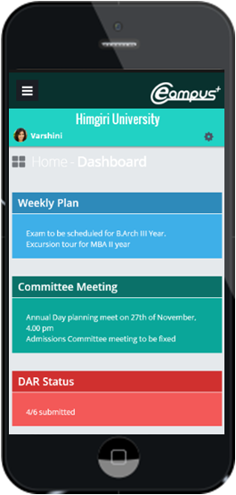


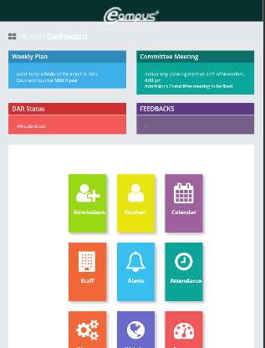
Multiple Device Access
Application built on latest coding technology, enabling users to access the application using any device, be it desktop, laptop or mobile using the same UserID and Password
Exclusive app for students activities

Slide 22
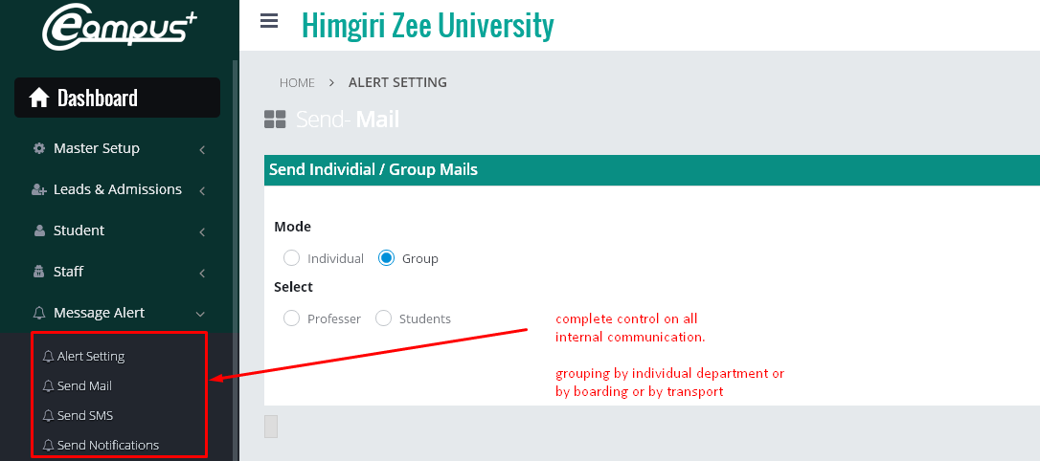
Effective Communication
Pre-set templates for immediate use. Latest Firebase technology to ensure 100% delivery of communication to correct audience.
15+ automated messages, including important Alerts, Fee Due, Library due, Assignment, Exam Schedules, reminders, etc

Slide 23
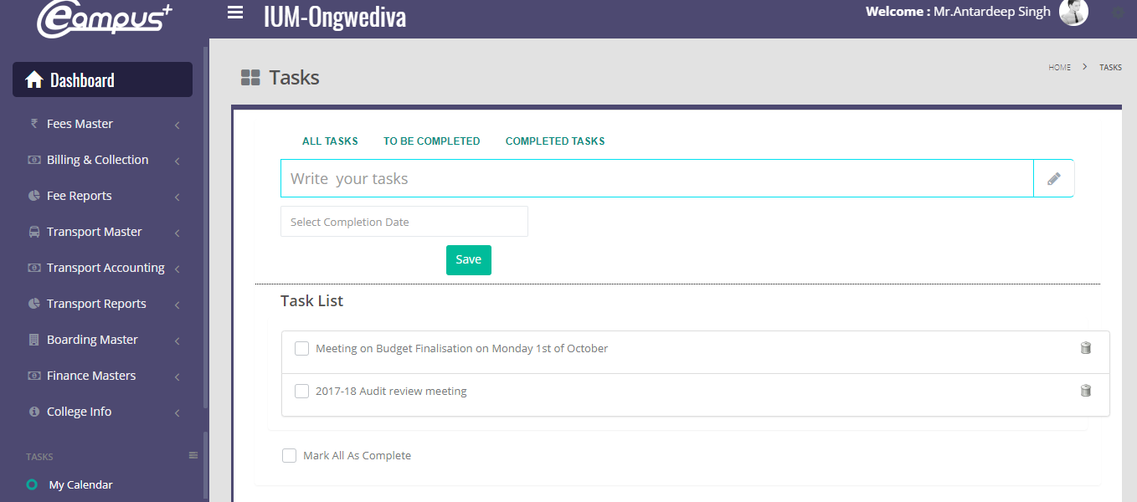
Important User Controls...
Simple tools to make eCAMPUS integral part of student life
Features like “Add my activities” in calendar and “My Tasks” section help students with their day to day use of application

Slide 24
Implementation & Integration
Dedicated Coordinator
Ensure regular support and off-line training
Customization
Customization of reports as per school formats
Initial data porting by Innovasphere team
Training
Continuous Up-gradation
Regular Handholding and Training
Data Porting
Videos with live data for easy understanding
Regular updates & feature additions in application
Frequent training and guidance online
Implementation and Review
Customisation suiting institute’s requirement

Slide 25

Want to know more?
•Please call us for a one-on-one session
• We will share current solution and understand your customisation needs
• We also share some unique solution
that may stand out
Contact us today and we will show you how
Phone: + 91 98410 34235
E-mail: aravind@innovasphere.in
Web: www.innovaecampus.com

